Slide 1
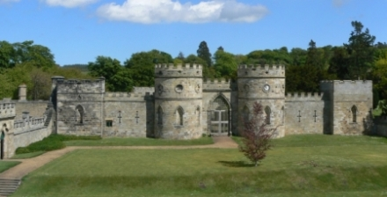
Ford Castle Residential
22nd – 24th May 2017

Slide 2
Why do we go?
Ford Castle Residential 22nd – 24th May 2017
Co-operation
Challenge
Confidence
Celebrate

Slide 3
Before we go
Ford Castle Residential 22nd – 24th May 2017
Medical forms
Please complete and return medical forms. Mr Long is sending these out electronically. We would also appreciate nil-returns. Any medication should be given to Mr Pearson on the day of departure. Please give children any travel sickness medication before we set off from school.
Packing Bags
Please do this with your child. You will be provided with a list of items required for the trip. We will be bringing school water proof clothing with us.
Souvenirs and Tuck Shop
We will have access to the tuck shop on our final evening. We ask that the children bring no more than £1 for the sweets/pop meal deal. There is a form to complete if you wish to order a t-shirt. If so, could we ask for any preorder forms to be returned tomorrow – money isn’t necessary.
Other merchandise is available from the tuck shop and detailed in the pack. Could we ask for any money to be sent in a named envelope, with an itemised breakdown of expenditure.

Slide 4
Before we go
Ford Castle Residential 22nd – 24th May 2017
Meals
Whilst at Ford Castle, the children will have 3 meals per day.
Hot/cold breakfast
Packed lunch (provided by Ford Castle – based on children’s choices)
Evening meal
Photographs
Staff will take as many photos as possible to try and capture the children’s experiences. We’ll share some of these with you on the Friday we return, with lots being posted on the school website. There will also be a Ford Castle DVD, which will be handed out at Brinkburn.

Slide 5
Departures and arrival
Ford Castle Residential 22nd – 24th May 2017
The morning
Parents can come into the school hall with their children from 8:50am. We will give labels for the children’s bags and share groupings. Following some team photographs, the children will have to wait a little longer before we depart at around 10:15am.
Arrival
Once we arrive at Ford Castle, the children will be given the tour, along with a safety brief and expected code of conduct. Then, we will have lunch. Following that, we will begin our first activities.

Slide 6
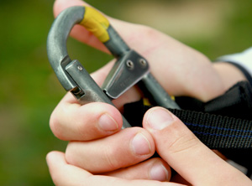
Safety
Ford Castle Residential 22nd – 24th May 2017
Ensuring enjoyment for all
There is no compromise in regards to the children’s safety.
Each activity is led by a qualified instructor who ensure that safety equipment is checked, checked and checked again.
Whilst at an activity , the Ford Castle staff are in charge.
Between activities, children will have access to different areas of the castle. Their school leader will determine how this time is spent.

Slide 7
Activities
Ford Castle Residential 22nd – 24th May 2017
Eco-trail along the coast
Crate stack
Search and Rescue
Night Line
Disco
Castle Quest
Jacobs Ladder
High All Board
Archery
Zipwire
Assault Course
Fencing

Slide 8
Night Time
Ford Castle Residential 22nd – 24th May 2017
After a great day of activities…
The children have allocated dorms – 2 boy dorms and 2 girl dorms.
Ford Castle Staff are on site during the night, however school staff are responsible for the children’s well-being..
Should children need assistance during the evening, they knock for a member of school staff. Both members of school staff will be woken in any event and a log will be kept.
The famed ‘Blue Book’ of Robinwood will make its way to Ford Castle.
Contacting Parents
No news is good news!

Slide 9
Coming Home
Ford Castle Residential 22nd – 24th May 2017
Our final morning
The children will be asked to finish packing their bags and bring their luggage to the pick up point. They will then complete their final activities and have lunch.
Arrival at school
We anticipate being back at school around 3:00pm on Wednesday 24th May. Mr P will text Mr Long on departure so that parents can, where possible, be here to welcome the children home.

Slide 10
Celebration Assembly
Ford Castle Residential 22nd – 24th May 2017
Friday 26th May
We invite parents to come into school for a special assembly led by the Adventurers. This will begin at 2:30pm and will finish at the end of the school day.

