Slide 1
Felton C of E Primary School
Adventurers’ Parent Information Evening
Notes:
Example booklet of phonics book 4 and book 7

Slide 2
School Vision
‘Loving, Learning, Living as we journey together to enable everyone to flourish.’
We love God, ourselves and one another. We love and care for our world and our neighbours, locally and globally.
We learn from one another and grow in wisdom from the experiences we encounter so that we are equipped and enabled to become the people we were created to be.
We live together in peace, trust, and with respect. We forgive one another and bring hope to our world.

Slide 3
The School Day
8.45 Registration
8.50 - 9.15 Phonics/Spelling
9.15 - 9.30 Collective Worship
9.30 - 10.30 Session 1
10.30 - 11.00 Break and snack
11.00 - 12.00 Session 2
12.15 - 1.00 Lunch
1.00 - 3.00 Afternoon session
3.00-3.15 Class story

Slide 4
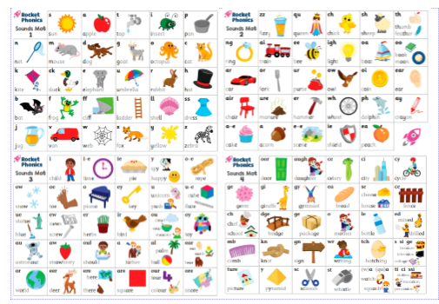
Phonics
Phonics and spelling groups based upon recent phonics & spelling assessments.
Spelling overviews for each group will be sent home
No weekly spelling ‘tests’ - the focus will be application of spelling rules in the children’s writing.

Slide 5
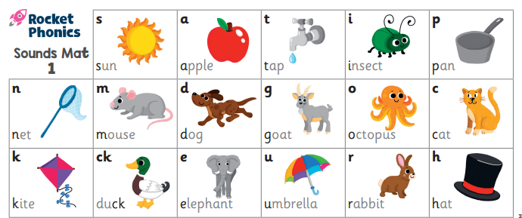
Phonics
Phonemes are the smallest units of sound within a language. They are represented in writing by symbols known as graphemes, and they help us to distinguish one word from another.
Children will learn about phonemes during phonics, the study of sounds. For instance, they might learn how the word ‘dog’ is made up of three phonemes: /d/, /o/ and /g/

Slide 6
Phonics
Digraphs are two letters that make one sound.

Slide 7
Phonics
Split digraph
Sometimes the two letters are not next to each other.

Slide 8
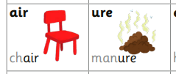
Phonics
Trigraphs are three letters that make one sound.

Slide 9
Phonics
Alternative sounds
https://www.youtube.com/watch?v=vuPUrPNrhOg&list=PLkCyTyvoxZztJbDs1Sp3-9MoywMKBhhwp&index=7
This link gives examples of how to pronounce the sounds. All sounds from pink books to orange books are covered in the 13 video clips.

Slide 10
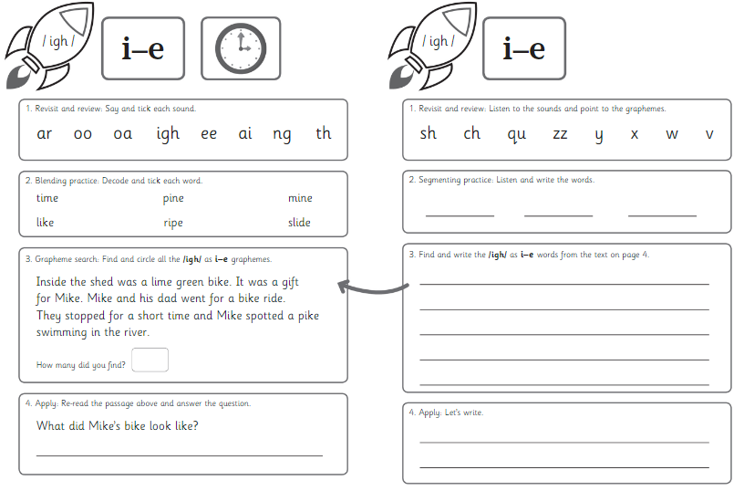
Phonics
What phonics looks like in Adventurers. Two sounds per week.
Day 1 is reading
Day 2 is writing
Friday is common exception words

Slide 11
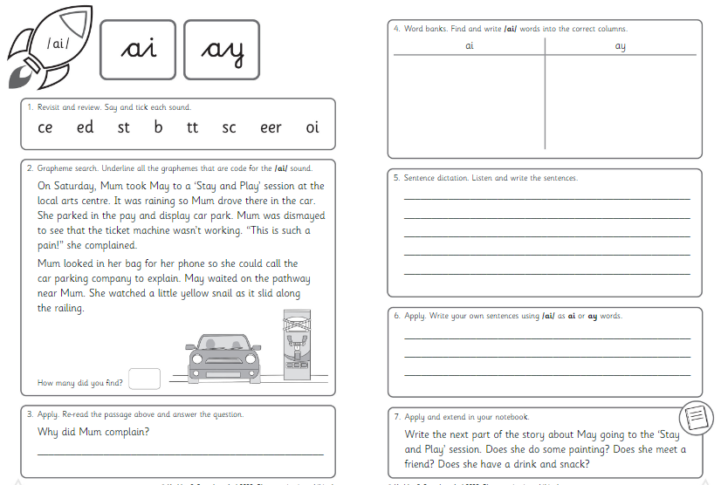
Spelling
Spelling groups based upon recent spelling assessments
Spelling overviews for each group will be sent home
No weekly spelling ‘tests’ - the focus will be application of spelling rules in the children’s writing.
Spelling rules will include alternative sounds in words and rules including suffixes, homophones and near homophones.

Slide 12
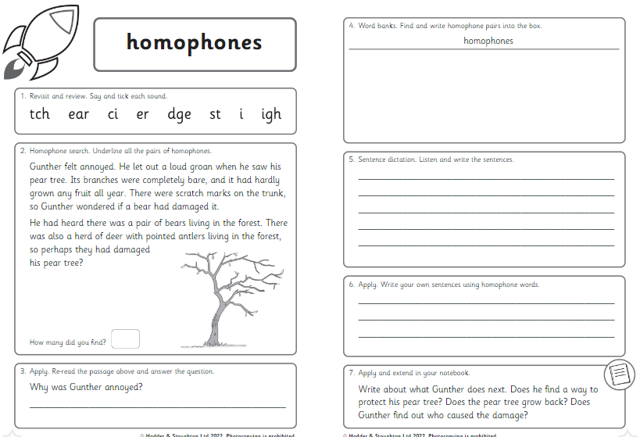
Spelling
What spellings look like in Adventurers.

Slide 13
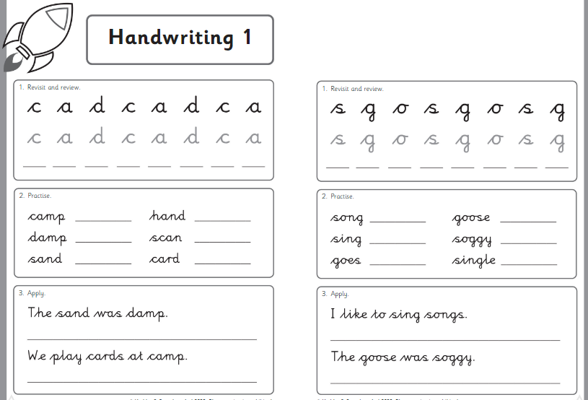
Spelling
Spelling groups based upon recent spelling assessments
Spelling overviews for each group will be sent home
No weekly spelling ‘tests’ - the focus will be application of spelling rules in the children’s writing.
Spelling rules will include alternative sounds in words and rules including suffixes, homophones and near homophones.

Slide 14
Reading
Children will will bring one book linked to their current reading level and one reading for pleasure book.
We will give the children a reading record in which they can record their reading at home and their responses.
Once the children have reached the end of the book bands.
We will share our class story at the end of each school day.

Slide 15
Reading
When an adult listens to your child read this will be in a ‘Guided Reading’ group.
The group will read the same book, the adult will listen to each child read at their own pace.
After the adult has listened to all children read the adult may ask some questions about what they have read.
The questions will be based on something called VIPERS.

Slide 16
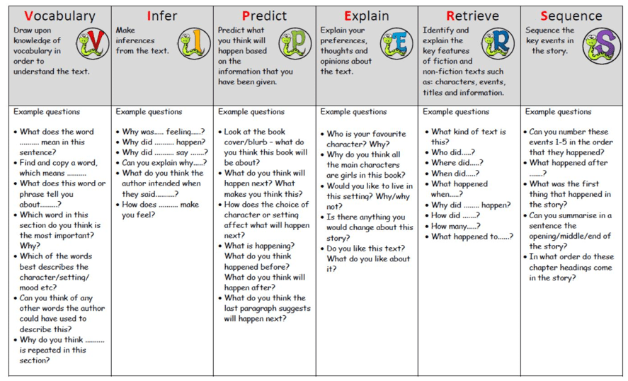
VIPERS

Slide 17
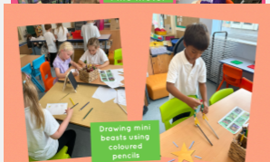
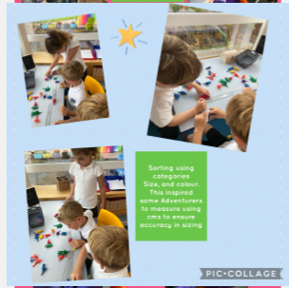
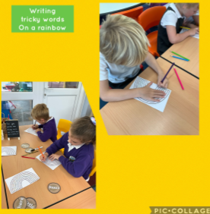
Provision Challenges
Provision challenges are set weekly in the classroom for the children to access independently.
The children will be completing activities linked to prior learning (from the week before) or learning we will be doing that week.

Slide 18
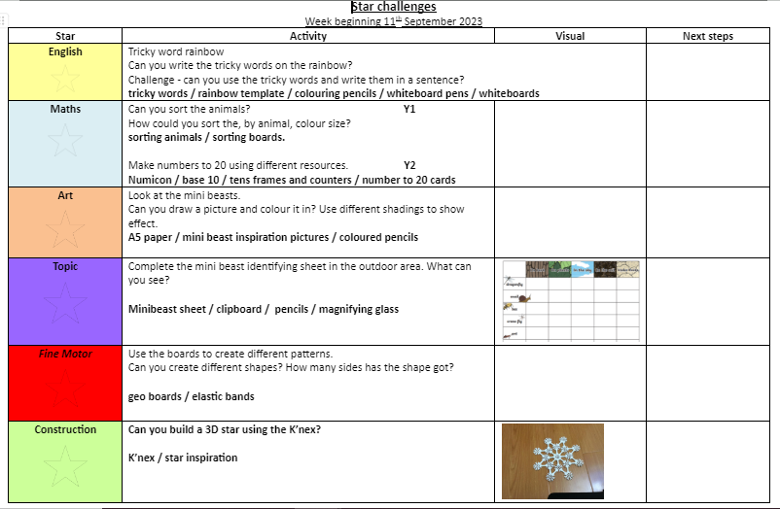
Provision Challenges

Slide 19
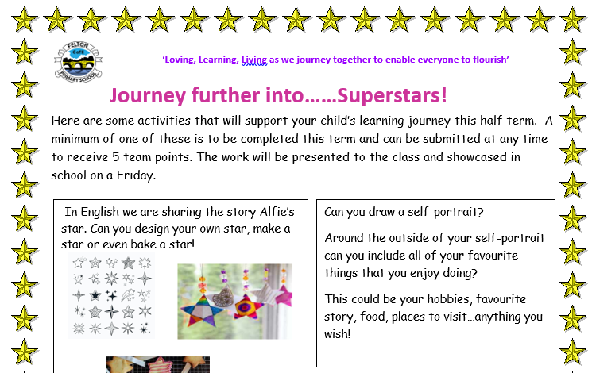
Homework
‘Journeying Further In…’ homework choices:
Each homework task completed will be shared with the class and will be awarded 5 team points.
No limit to the number of tasks the children can contribute and they must try to complete at least one each Learning Journey.
Reading and spellings
Read once a day/look at spellings.
Education City:
usually an English and Maths task linked to their current or recent learning.
Set on a Friday to be completed for the following Friday

Slide 20
Collective Worship
Monday Choral Praise
Tuesday Open the book & Rev’d Rich
Wednesday Picture News (KS1 & EYFS).
Thursday KS1 worship
Friday Stars & child led reflection

Slide 21
Snacks & Water Bottles
School do provide snack for KS1 (fruit or veg). If you wish for your child to bring in a snack of fruit and veg you can do.
Please ensure they have a refillable water bottle so they can stay hydrated throughout the day.

Slide 22
Packed lunches
Encourage healthy choices
No fizzy drinks, nuts or bars of chocolate
Finding a good balance

Slide 23
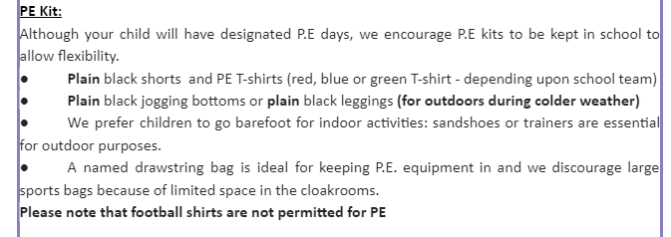
PE
PE days are Mondays and Thursdays:
Mondays: Bring PE kit to get changed into. Arrive in school in uniform to school on Tuesdays and will get changed into and out of their PE kits for the session.
Thursdays. Arrive in school in running kit/PE kit. If they’re in running kit they will need to get changed into PE kit. They do not need to bring in uniform for after PE on a Thursday.
Monday PE - dodgeball
Thursday PE - Football (external coach)

Slide 24
PE

Slide 25
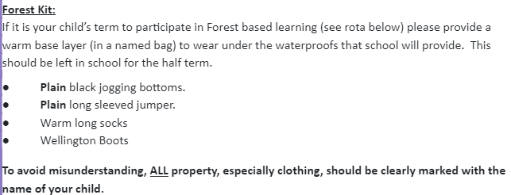
Forest & Swimming Schedule
Autumn term - Forest based learning
Spring Term - Swimming
Wednesday Afternoons

Slide 26
Behaviour Policy
Our school Rules are:
Loving
We love God, ourselves and one another. We love and care for our world and our neighbours, locally and globally.
Be kind, helpful and polite to everyone (kind hands, kind feet and kind words)
Be respectful to our school, the grounds and each other
Keep each other and yourself safe
Learning
We learn from one another and grow in wisdom from the experiences we encounter so that we are equipped and enabled to become the people we were created to be.
Listen when the teacher and others are talking
Follow instructions—always ask for help if you need it
Always try your best and have pride in your work.
Living
We live together in peace, trust, and with respect. We forgive one another and bring hope to our world.
Be honest
Have a positive attitude
Forgive and forget

Slide 27
Behaviour Policy
Following the school rules is rewarded with Team Points.
These points are collected for the team they belong to, Coquetdale (blue), Cheviot (red) and Simonside (green).
The totals for each of the three teams are celebrated each week during stars worship.
At the end of each half term the team that has collected the most special tickets receives a prize or gains special privileges e.g. own clothes day or hot chocolate during forest based learning.
Individual awards are given for:
Bronze -
Silver -
Gold -
Platinum -
Team Points

Slide 28
Behaviour Policy
Consequences are important because they:
empower the teacher
help children to make sensible choices about the way they behave
help keep everyone safe
inform parents of unacceptable behaviour
encourage parental support
promote consistency and fairness
The consequences of choosing not to follow the rules will be in the form of warnings – ALL children should be reminded of the school rules and given the chance to change their behaviour:
1. A spoken warning
2. Time away from group to reflect on behaviour
3 Recorded warning (yellow card) – 5 mins lost playtime
4 Recorded warning (red card) – 15 mins lost play time
5 Taken to HT/Senior Teacher - behaviour discussed and parents informed
6.Further sanctions – individual programme withdrawal of privileges or in the case of extreme behaviour - temporary exclusion
Consequences

Slide 29
E-Safety
Wake-up Wednesday updates - National College weekly e-safety information for parents and schools.
Issues can arise when children use social media platforms (including WhatsApp) - age restrictions are often minimum age 13 for most social media.
Addressed in PHSE

Slide 30
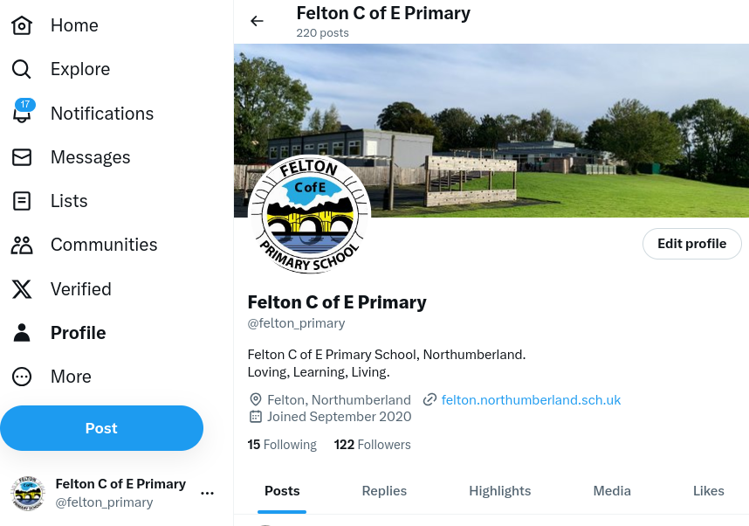
Twitter
https://twitter.com/felton_primary

Slide 31
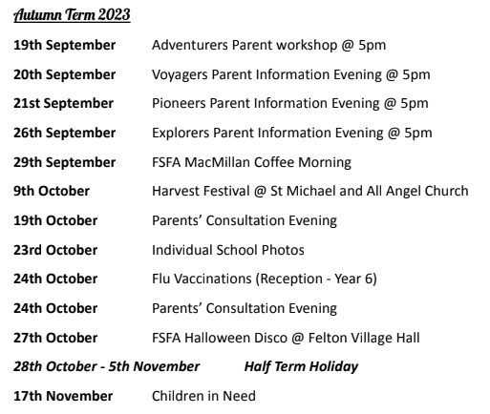
Calendar
Keen an eye out for key dates on Mrs Lucas’ monthly newsletter and the school website.
Lots of dates for the whole year have been put on the most recent newsletter that went out at the beginning of the year.

Slide 32
2023-24 Curriculum Overview
See school website for 2023-2024 Curriculum Overview.
Adventurers Class Page

Slide 33
Autumn 1 Learning Journey
See school website for Autumn 1 Learning Journey.
Adventurers Class Page - Super Stars!

Slide 34
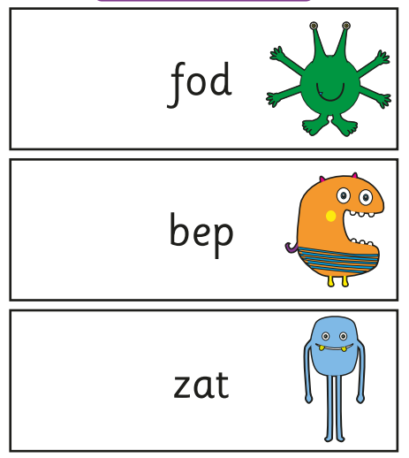
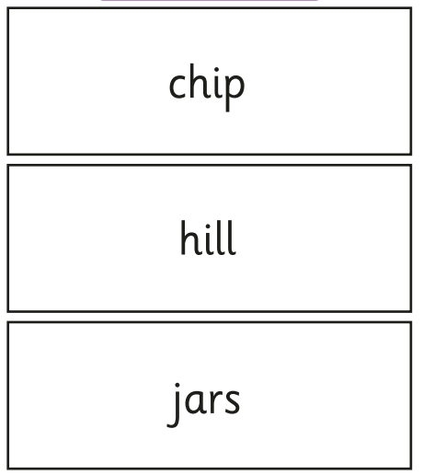
Phonics Screening Check
The phonics screening check contains 40 words divided into two sections of 20 words. Both sections contain a mixture of real words and pseudo-words. Pseduo-words are words that are phonically decodable but are not actual words with an associated meaning. Pseudo-words are included in the check specifcally to assess whether your child can decode a word using their phonics skills. All pseudo-words in the check are accompanied by a picture of an imaginary creature. Children are taught that when a word has a creature next to it, it is a pseudo-word. This is to ensure that they are not trying to match the pseudoword to a word in their vocabulary. The check is designed to give teachers information on how your child is progressing in phonics. It will help to identify whether your child needs additional support at this stage so that they do not fall behind in this vital early reading skill.
https://assets.publishing.service.gov.uk/government/uploads/system/uploads/attachment_data/file/1164731/Information_for_parents_-_2023_phonics_screening_check.pdf

Slide 35
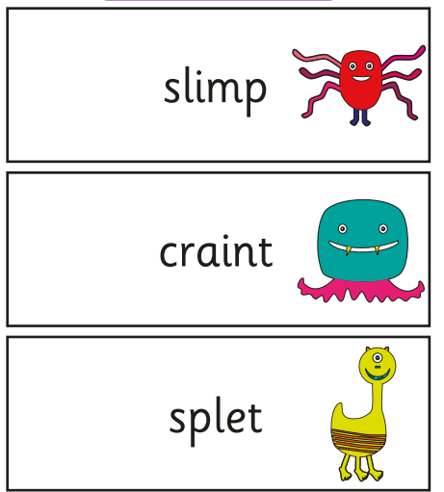
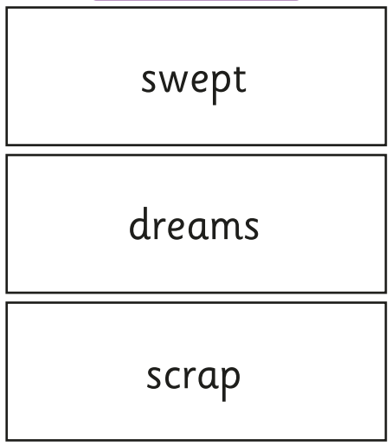
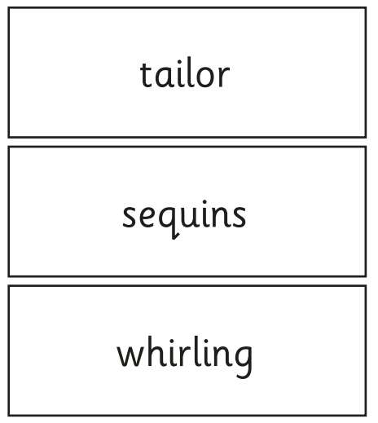
Phonics Screening Check
The phonics screening check contains 40 words divided into two sections of 20 words. Both sections contain a mixture of real words and pseudo-words (alien words). Pseduo-words are words that are phonically decodable but are not actual words with an associated meaning. Pseudo-words are included in the check specifcally to assess whether your child can decode a word using their phonics skills. All pseudo-words in the check are accompanied by a picture of an imaginary creature. Children are taught that when a word has a creature next to it, it is a pseudo-word. This is to ensure that they are not trying to match the pseudoword to a word in their vocabulary. The check is designed to give teachers information on how your child is progressing in phonics. It will help to identify whether your child needs additional support at this stage so that they do not fall behind in this vital early reading skill.

Slide 36
No SATs for Year 2 this year!

Slide 37
Transition Plans
A morning in July where children in Year 2 will be able to go into Voyagers for transition activities and meet the KS2 staff.

Slide 38
Visits, Felton Mile and Swimming
Visits
Felton Mile on a Thursday morning. Any parent help would be greatly appreciated. Either to run or to help marshall.
Swimming in Spring Term

Slide 39
FSFA
29th September FSFA MacMillan Coffee Morning!

Slide 40
Thank you!!
Any questions please feel free to get in touch.
I am more than happy to answer any questions you may have.

